Slide 1


LIFT: Integrating Stakeholder Voices into Algorithmic Team Formation
Emily M. Hastings, Albatool Alamri,
Andrew Kuznetsov, Christine Pisarczyk,
Karrie Karahalios, Darko Marinov, Brian P. Bailey
Notes:
Many of you have worked on a team project before. For the instructors, many of you have probably done team-based activities in your courses, and you may have even used algorithmic team formation tools to help make this process more efficient or easier.
Provide insight on how you could give students more of a voice when using algorithmic team formation tools in your courses

Slide 2
How should instructors form teams in their courses?
Notes:
•Instructors are increasingly using teamwork in their courses
•Need to decide how to form the teams
3 methods exist, random/self-selection have some weaknesses, increasingly popular option is...

Slide 3



Criteria-based Team Formation
Strategically select team members to achieve certain compositions
Skill diversity (e.g., Brickell et al. 1994, Horwitz and Horwitz 2007)
Balanced personality types (e.g., Lykourentzou et al. 2016)
Balanced genders (e.g., Jehn, Northcraft, and Neale 1999)
Many more
Notes:
First one is composition. Criteria-based team formation. Careful with wording-- Woolley will be there
Algorithmic team formation tools help implement this approach

Slide 4
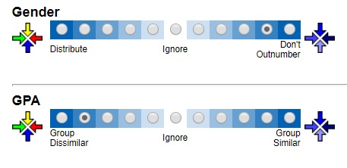

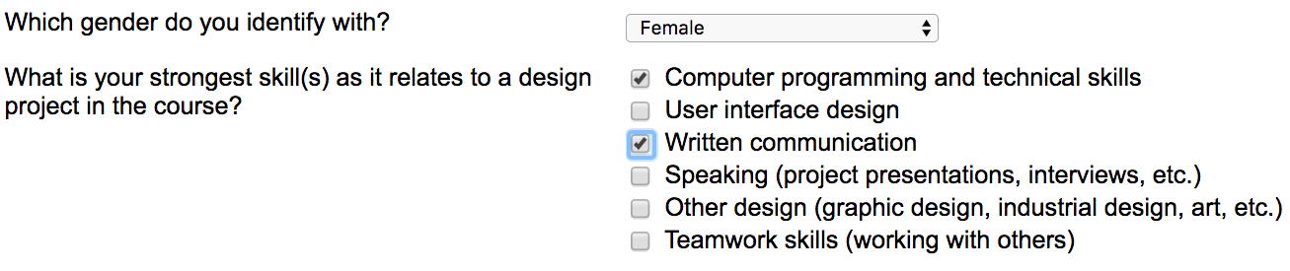
Algorithmic Team Formation Tools
Notes:
Example of a representative tool-- CATME

Slide 5
The problem
Tools assume that the instructor should configure the inputs to the algorithm
Students have little input
Potential benefits of increased knowledge and control
Prevent viewing the algorithm as a “black box” (e.g., Blowers 2003)
Increased satisfaction and acceptance (e.g., Vaccaro et al. 2018, Cramer et al. 2008, Kizilcec 2016, Lee et al. 2015)
Greater ownership of group problems (e.g., Mello 1993)
Notes:
Students have little input despite having potentially useful localized knowledge of their experiences and the fact that these decisions will impact their experiences, learning, etc.

Slide 6
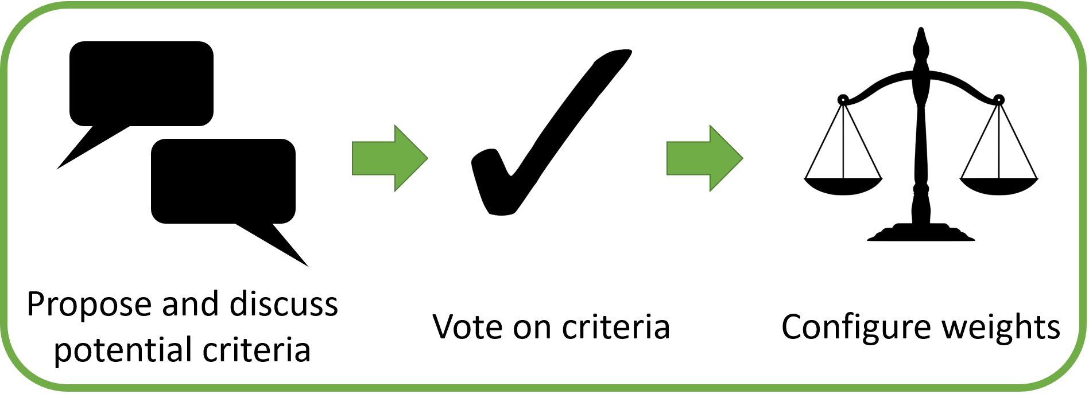
The LIFT Workflow
Notes:
Because of these potential benefits, developed LIFT-- learner involvement in forming teams
Explain
This approach is grounded in theories of crowdsourcing and collective intelligence, and inspired by prior successes of the use of crowdsourcing techniques in learning environments

Slide 7

Experimental Design
Mixed-methods between participants experiment (N=289)
Interviews with 18 students and 6 instructors
Condition 1: Learner (LIFT)
Condition 2: Instructor (Control)
Notes:
https://www.needpix.com/photo/download/667974/professor-class-free-pictures-free-photos-free-images-royalty-free-free-illustrations

Slide 8
Measures
Project Grades
Perceived Performance
Satisfaction with Team Assignment
Satisfaction with Team Formation Process
Recommendation to Repeat Approach
Perceived Agency
Importance of Input
Notes:
We had a number of dependent variables….
Wanted to measure effects on these variables/outcomes
Collected via post-survey

Slide 9
Results

Slide 10
RQ1: What team formation criteria do students select when given the chance? How do student and instructor choices differ?

Slide 11
RQ1: Student Criteria Choices
75 criteria discussed in total, 48 (64%) newly-proposed
E.g., Organizational style
3 broad categories:
Team management (e.g., Leadership role, Teamwork experience)
Academics (e.g., GPA, Software skills)
Identity (e.g., Gender, Personality type)
Voting phase eliminated all less serious criteria
Most popular: scheduling, skills, work habits
Least popular: aspects of past and identity not under present control
Notes:
Invite to see the paper for more detail on the criteria and votes
Distribute skills, easier meetings
Favored criteria related to immediate topics that could help complete the project more conveniently
Voted against or disregarded gender, gpa, etc

Slide 12
Instructor Criteria Choices
All instructor criteria selected from tool
Prioritized learning and long-term success over minimizing present conflict
“High achievers may need to be in teams with other high achievers so that they have this sort of conflict...[and] can work through a disagreement with another student. I think it is a wonderful opportunity for growth.” (I2)

Slide 13
RQ2: How do students perceive their agency when they are allowed to have input into the team formation process?

Slide 14
RQ2: Student Perceptions of Agency
Students found it important to have a voice (median 6.0)
Median agency score in Learner condition was higher (median 5.0 vs 4.0), but not statistically significant (Wald χ2(1)=3.05, B= 0.77, p=0.08)
Possible explanation: participation vs. choice
Notes:
students in the Instructor condition participated in the process via the survey but did not have a choice in which criteria were on the survey, or how the criteria would be weighed

Slide 15
RQ2: Student Perceptions of Agency
Strengths:
LIFT can provide insight to instructors who are disconnected from the student team experience (S=10)
LIFT contributed to increased sense of ownership (S=5)
Weaknesses:
Students are not experts on what makes a good team (S=6)
Instructors more familiar with the course and what skills will be necessary (S=8)
Concerns of gaming (S=5)

Slide 16
RQ3: How does allowing students to select criteria affect their team performance, satisfaction, and other course experiences compared to having instructors select criteria?

Slide 17
RQ3: Effects of Criteria Selector on Outcomes
High across conditions
No significant effect of criteria selector
Potential explanations:
Specifics of criteria configuration may not be most important factor in outcomes
Expectation effect (Hastings et al. 2018)

Slide 18
RQ4: How do instructors perceive transferring agency in the team formation process to students, and what do they learn about student preferences?

Slide 19
RQ4: Instructor Perceptions
Found student choices reasonable overall, including confirming personal doubts:
“Was GPA on? See, GPA is not even on there! Gosh, see that! The students are smarter than me… See, I guess I wish [I had] heard or learned this earlier.” (I2)
Some doubts about irrelevant criteria, gaming concerns, excluding important criteria:
“That's a hard question... there's a lot of literature on gender and achievements and race, like we should really pay attention to that, but then again I don't know. I'm not the students, and I don't know what their biases are, if they have biases... all I know is literature so... I don't know. I don't know if I trust that much that they know themselves so well.” (I3)
Notes:
From the interviews

Slide 20
RQ4: Instructor Perceptions
Three instructors would adopt LIFT as-is, a fourth would integrate student criteria into his own configuration
Responsibility, motivation, sense of ownership
Remaining two instructors were reluctant to adopt due to key exclusions or large course sizes
Notes:
From the interviews

Slide 21
Implications for Instructors
Possible to incorporate student input into algorithmic team formation without adversely affecting grades or team experiences
Alternatives to full LIFT workflow:
Adopt simplified version of LIFT for convenience
E.g., vote only on weights
Integrate student- and instructor-chosen criteria in a single configuration
Protect voices of minority students

Slide 22
Implications for Tool Designers
Incorporate features to delegate algorithmic control to students
E.g., surveys, discussion forums
Include elements of LIFT workflow directly in the tool rather than relying on external platforms
Precautions against possible manipulative behavior
E.g., reduce reliance on self-reported data, collect survey responses before revealing weights

Slide 23
Contributions
Deeper empirical understanding of the effectiveness of leveraging learners' collective choices to shape the algorithmic team formation process
Learner-centered workflow instructors can deploy to tap into the criteria that matter most to students in their specific courses
Practical implications for how designers of team formation tools can give stakeholders more control over the algorithmic team formation process
Thank you to our participants!
Contact info:
Emily Hastings (ehstngs2@illinois.edu)
Notes:
In conclusion, this work contributed….

